Slide 1
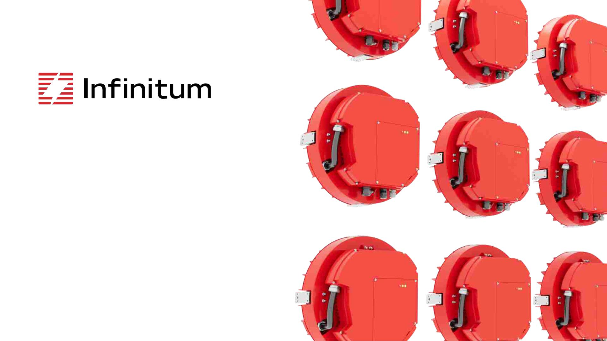
Aircore EC
Designed to go beyond
D a t e X X . X X . X X

Slide 2
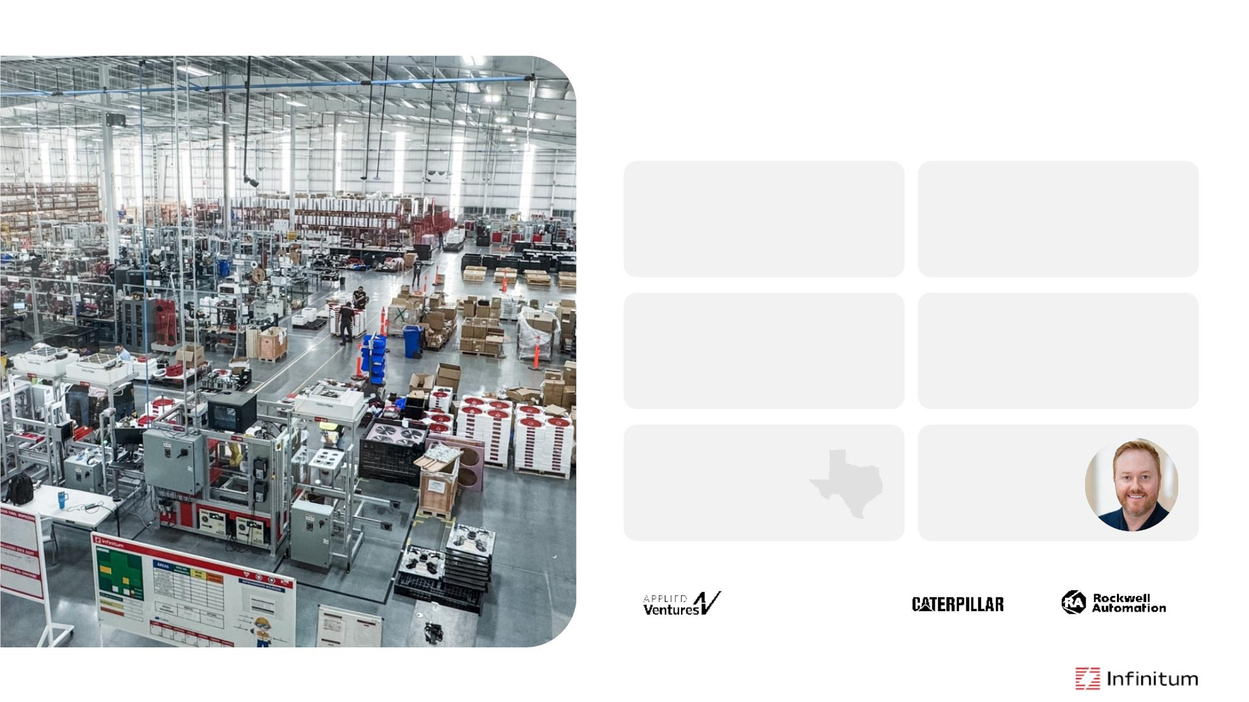
Infinitum
[in-fuh-nahy-tuhm]:
to infinity; endless; without limit
500+ 66% 50%
PROJECTS COMPLETED
LESS COPPER
LIGHTER
108 200+ 22+
PATENTS
EMPLOYEES
INDUSTRY AWARDS
ESTABLISHED
IN 2016
FOUNDER & CEO,
BEN SCHULER
HEADQUARTERED
IN AUSTIN, TX
Over $388m raised to design, develop and scale production of a revolutionary integrated motor and inverter.
chevron
technology
ventures

Slide 3
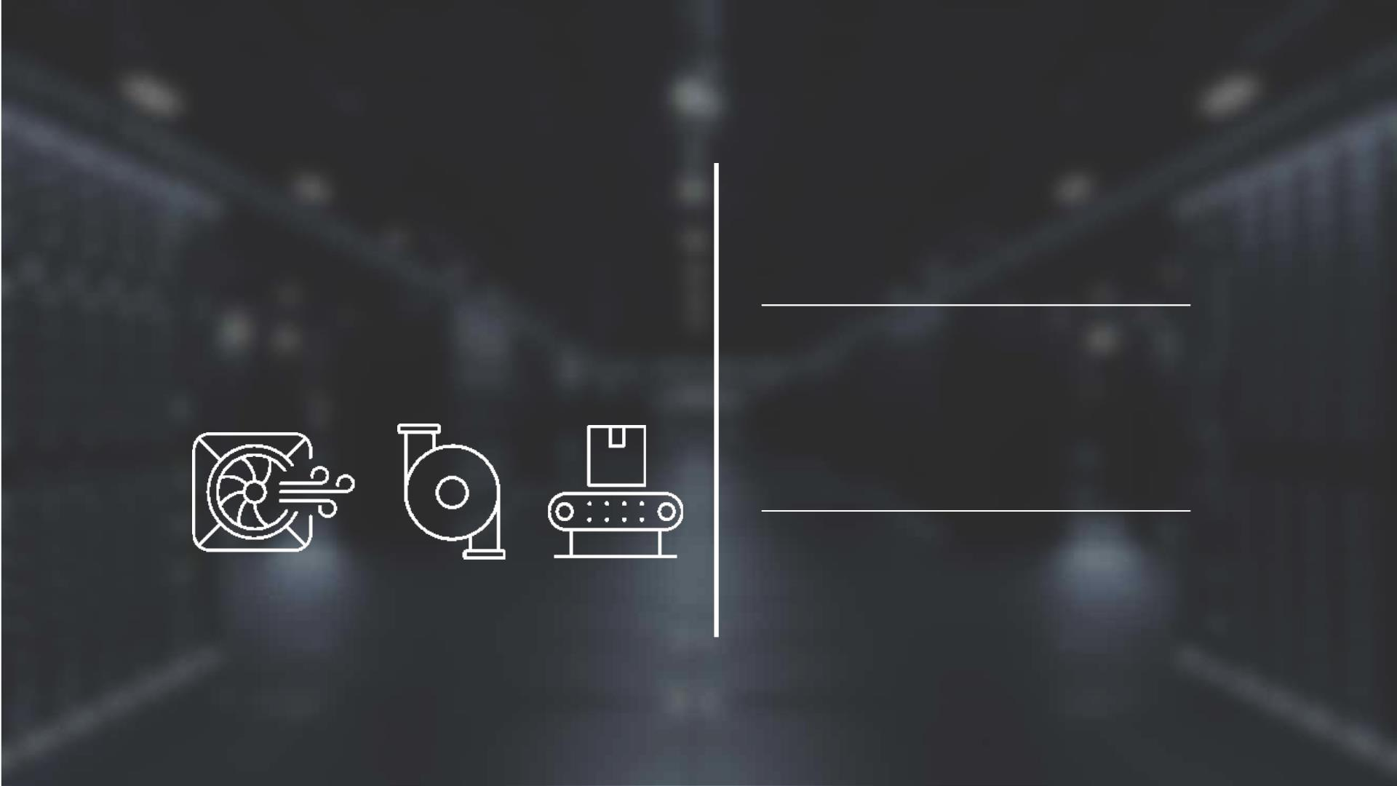
45,000+
S A V E or more
Motors
D E P L O Y E D A C R O S S
42%AMPs
with Infinitum
Aircore EC
MULTIPLE CRITICAL
APPLICATIONS
150+
customers
40k
UNITS
CURRENTLY
COMMITTED
HVAC • DATA CENTERS • FANS • PUMPS
M A T E R I A L H A N D L I N G • P O W E R G E N

Slide 4
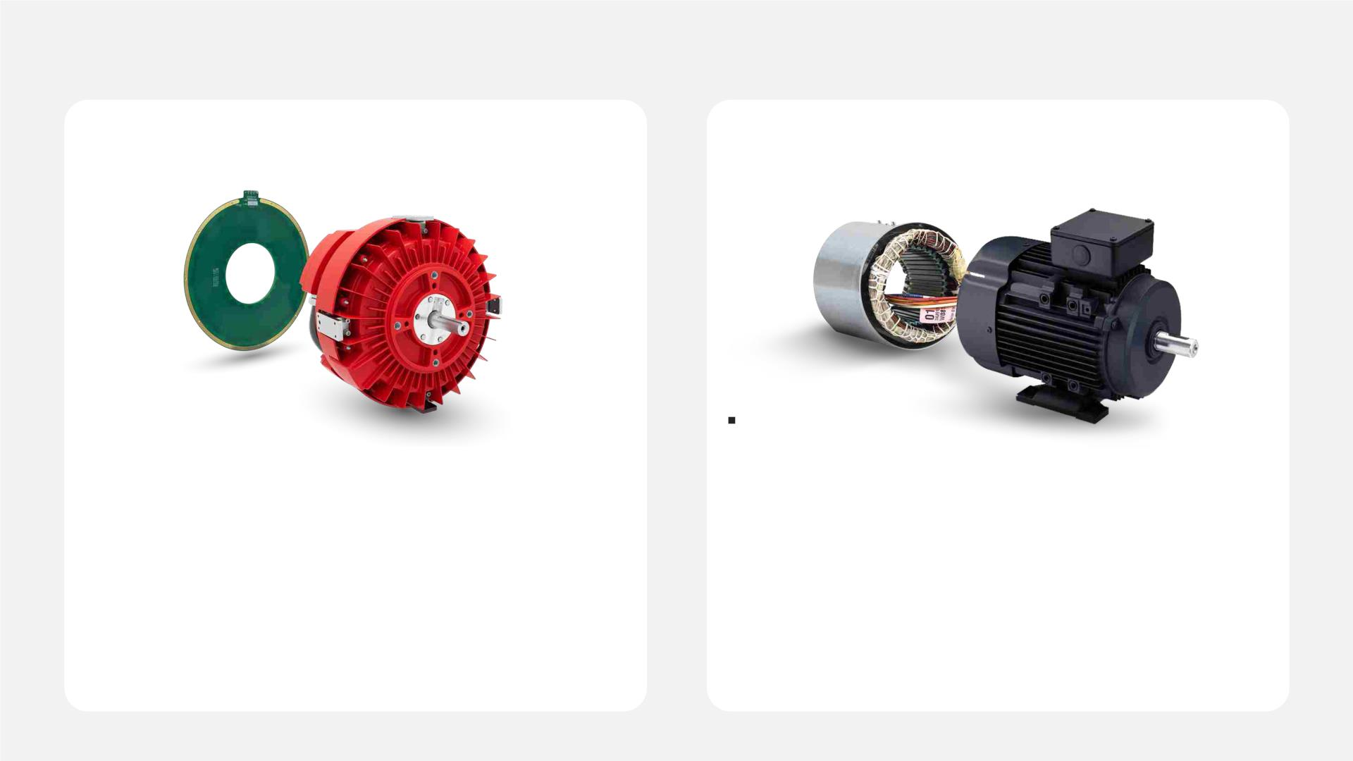
Infinitum EC Motors vs AC Induction Motors
Aircore EC Motor
AC Induction Motor
VS
Power, Intelligence & Controls All in One
• No iron
AC Induction Motor and External VFD
• Heavy iron core
• 66% less copper
• Copper winding failures are common
• High noise level
• Lightweight PCB stator lasts 10x longer
• 10% More efficient (at partial load)
• Embedded connectivity
• Low efficiency
• Easily damaged by overheating
• Additional VFD pairing required
• Not recyclable
• Recyclable, repairable and sustainable
4
©2025 Infinitum | All rights reserved

Slide 5
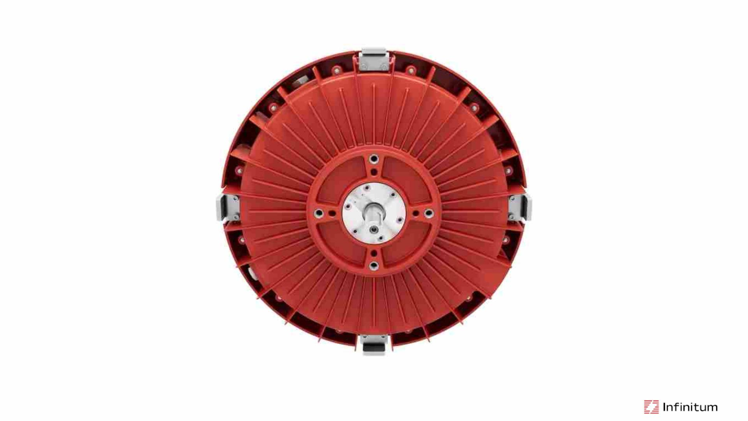
Motor and Drive in a Single Compact Package
5
©2025 Infinitum | All rights reserved

Slide 6
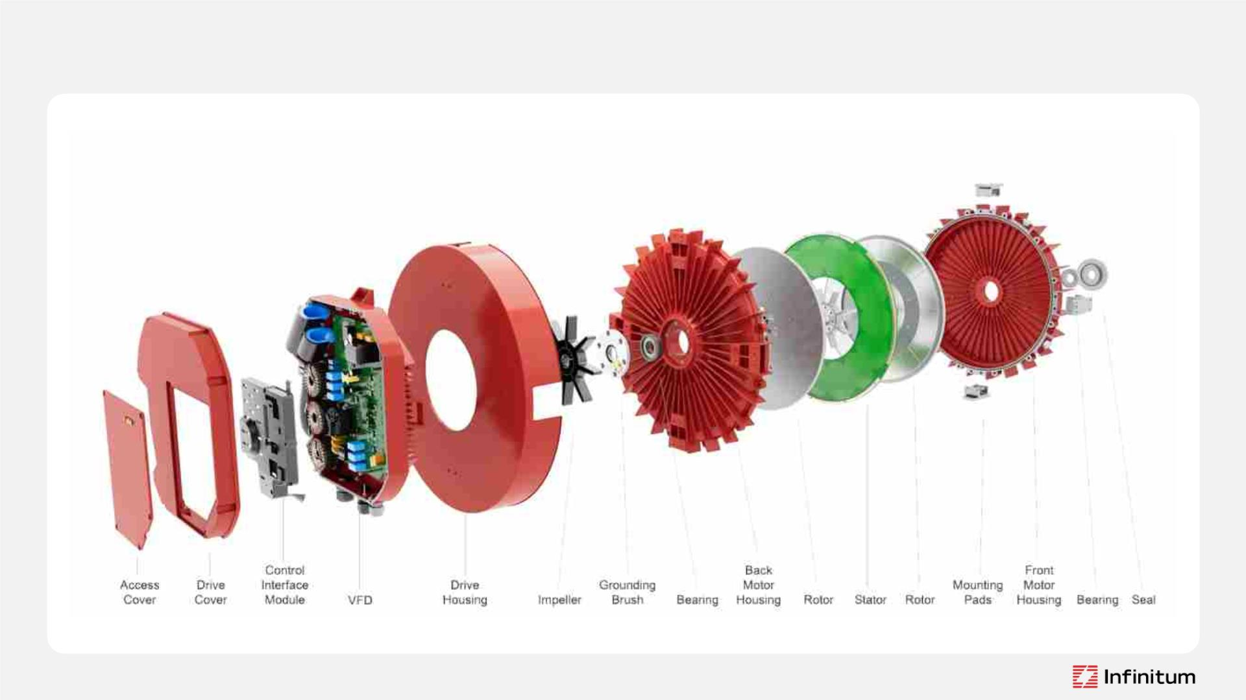
Motor and Drive in a Single Compact Package
6
©2025 Infinitum | All rights reserved

Slide 7
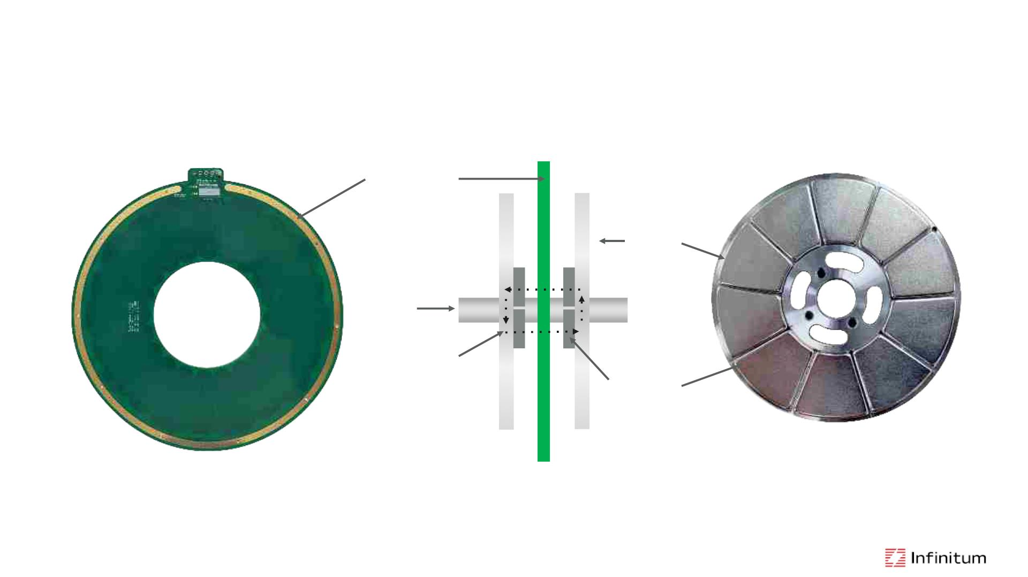
Permanent Magnet Synchronous Axial-Flux Motor Topology
PCB Stator
Rotor
Shaft
Magnetic
Field Path
Magnets
VFD energizes PCB Stator and creates a magnetic field that generates torque to turn Rotors and Shaft
7
©2025 Infinitum | All rights reserved

Slide 8
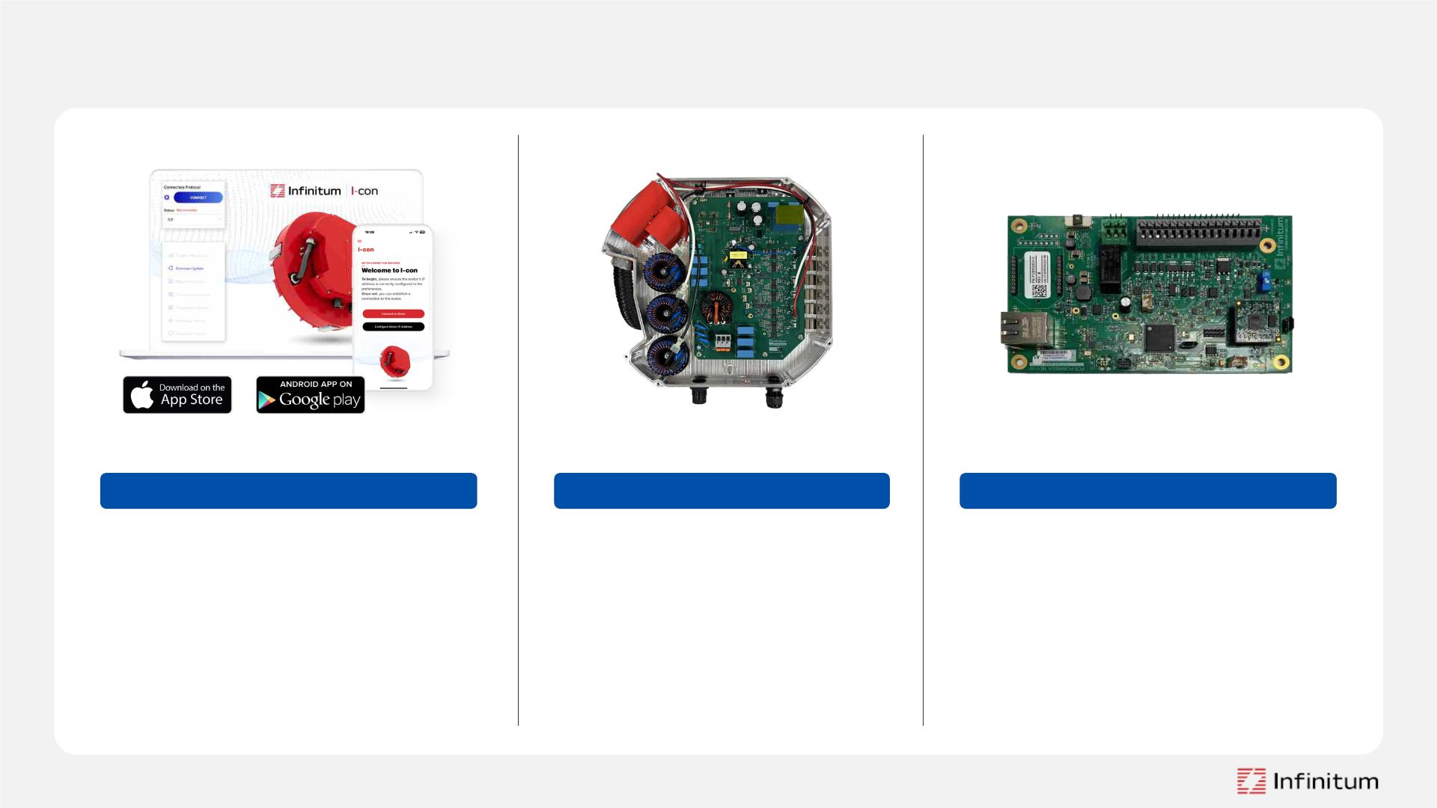
Positioned for Intelligence
C O N T R O L S O F T W A R E
V F D
U S E R C O N F I G U R A B L E
•
•
Wired Connection
•
•
State-of-the-Art Design
•
•
•
•
Min and Max Operating Speed
Motor Control Options
Modbus TCP (RJ45 Ethernet)
or Modbus RTU available
MODBUS-RTU and
BACnet MS/TP
•
•
Motor Monitoring
•
•
0-10V DC or 4-20mA available
for variable speed control
Fine Tune Motor Operation
Fail-over Operations
Motor Performance
Pre-configured Settings
8
©2025 Infinitum | All rights reserved

Slide 9
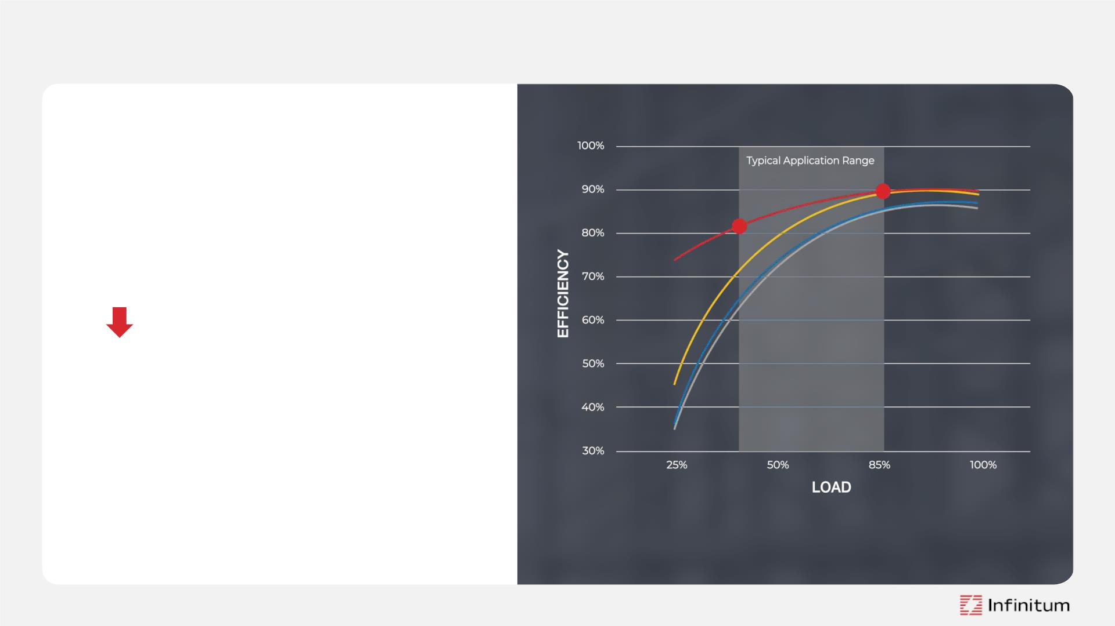
Class-Leading Efficiency
Flat motor efficiency curve
• Similar or better system efficiency
• Better than AC Induction Motor/VFD below 70% load
• Better than EC Fan motor above 70% load
Wire-to-air efficiency (motor + VFD + fan)…
•
AMCA Standard 207-17 used to calculate
the overall efficiency of a fan system
•
The Fan Energy Index (FEI) used to calculate
the input power against the actual electrical
power of a fan
=Infinitum (motor + VFD) =EC motor =AC Induction (IE4 motor + VFD) =AC Induction (IE3 motor + VFD)
9
©2025 Infinitum | All rights reserved

Slide 10
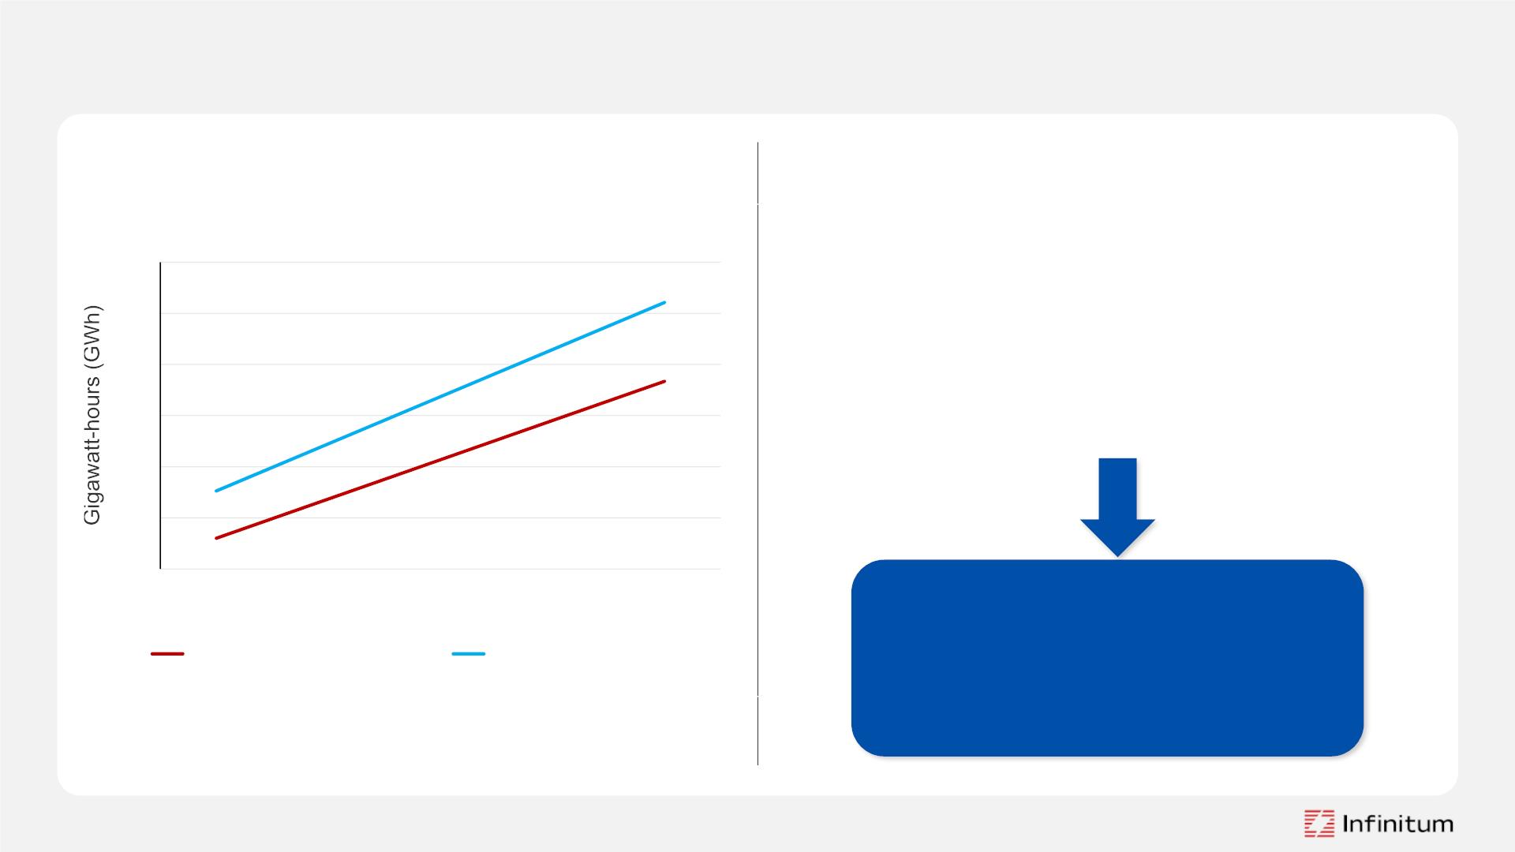
A Motor System that Saves Energy While Saving You Money
1,000 Infinitum motors used in a
commercial HVAC application will have
substantial cost and energy savings.
Energy Use Comparison – HVAC Application
100
90
80
70
60
50
40
Over a 10-year period, these motors will save
Ø 15 GWh
Ø 10,000 metric tons of CO2 avoided
6
7
8
9
10
Equivalent to
$2,000,000
Years
Infinitum Motor System
Competitor Motor System
in energy bill savings
*Source: U.S. Energy Info Administration (April 2025) $0.131/kWh
Infinitum motor is 10 HP 1800 RPM, rated IE5 + VFD and AC Induction motor is
IE4, 10 HP 1800 RPM + VFD.
10 ©2025 Infinitum | All rights reserved.

Slide 11
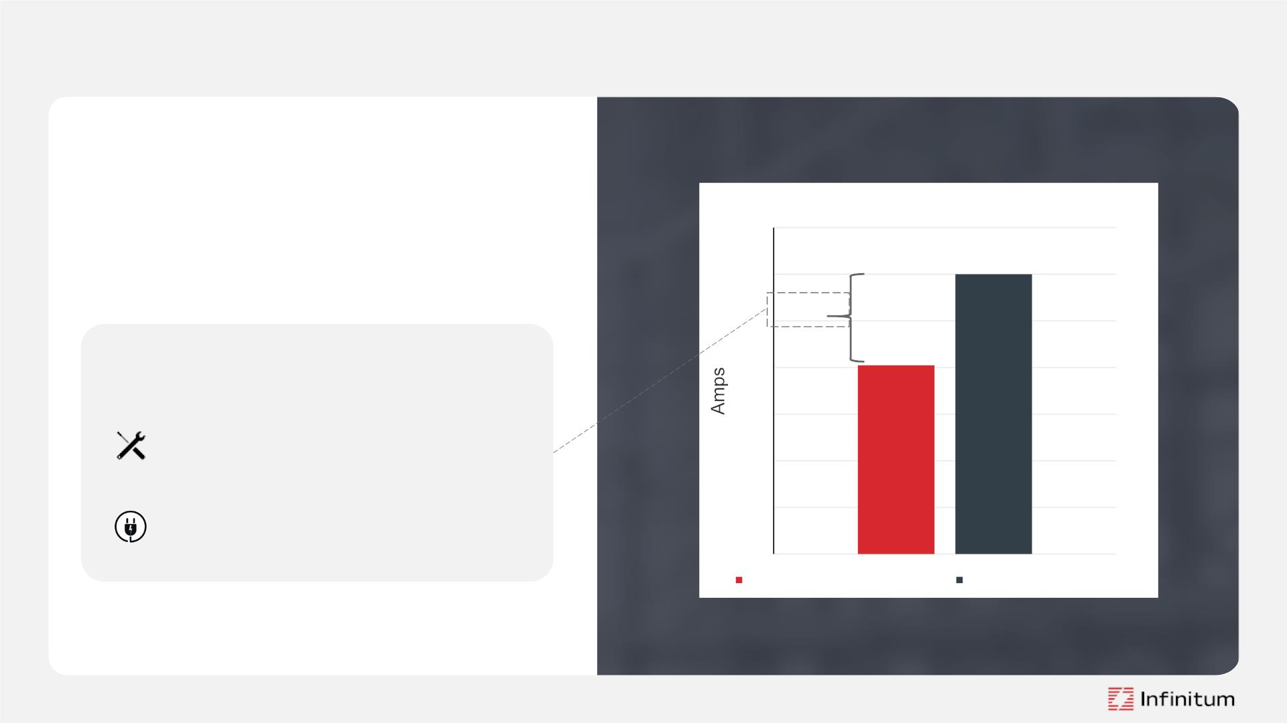
Right-Sized Nameplating
Right-sized vs Standard Nameplate
Right-sizing allows motors to be labeled
according to the specific load point of an
application due to our flat efficiency curve.
14
12
10
8
4.9 A
Right-sized nameplating key benefits:
6
Reduced CapEx on electrical
infrastructure
4
Increased capacity for other
equipment
2
0
Right-sized 5.9 HP 1225 RPM
Standard 10 HP 1800 RPM
11 ©2025 Infinitum | All rights reserved

Slide 12

Reduced CapEx
Right-sized vs Standard Nameplate
The lower current consumption reduces
CapEx costs by downsizing upstream
electrical infrastructure.
14
12
10
8
4.9 A
A lower amperage requires thinner
wires, smaller circuit breakers and
smaller transformers, resulting in:
6
Cost savings
4
2
Decreased Scope 3 emissions
0
Right-sized 5.9 HP 1225 RPM
Standard 10 HP 1800 RPM
12 ©2025 Infinitum | All rights reserved

Slide 13
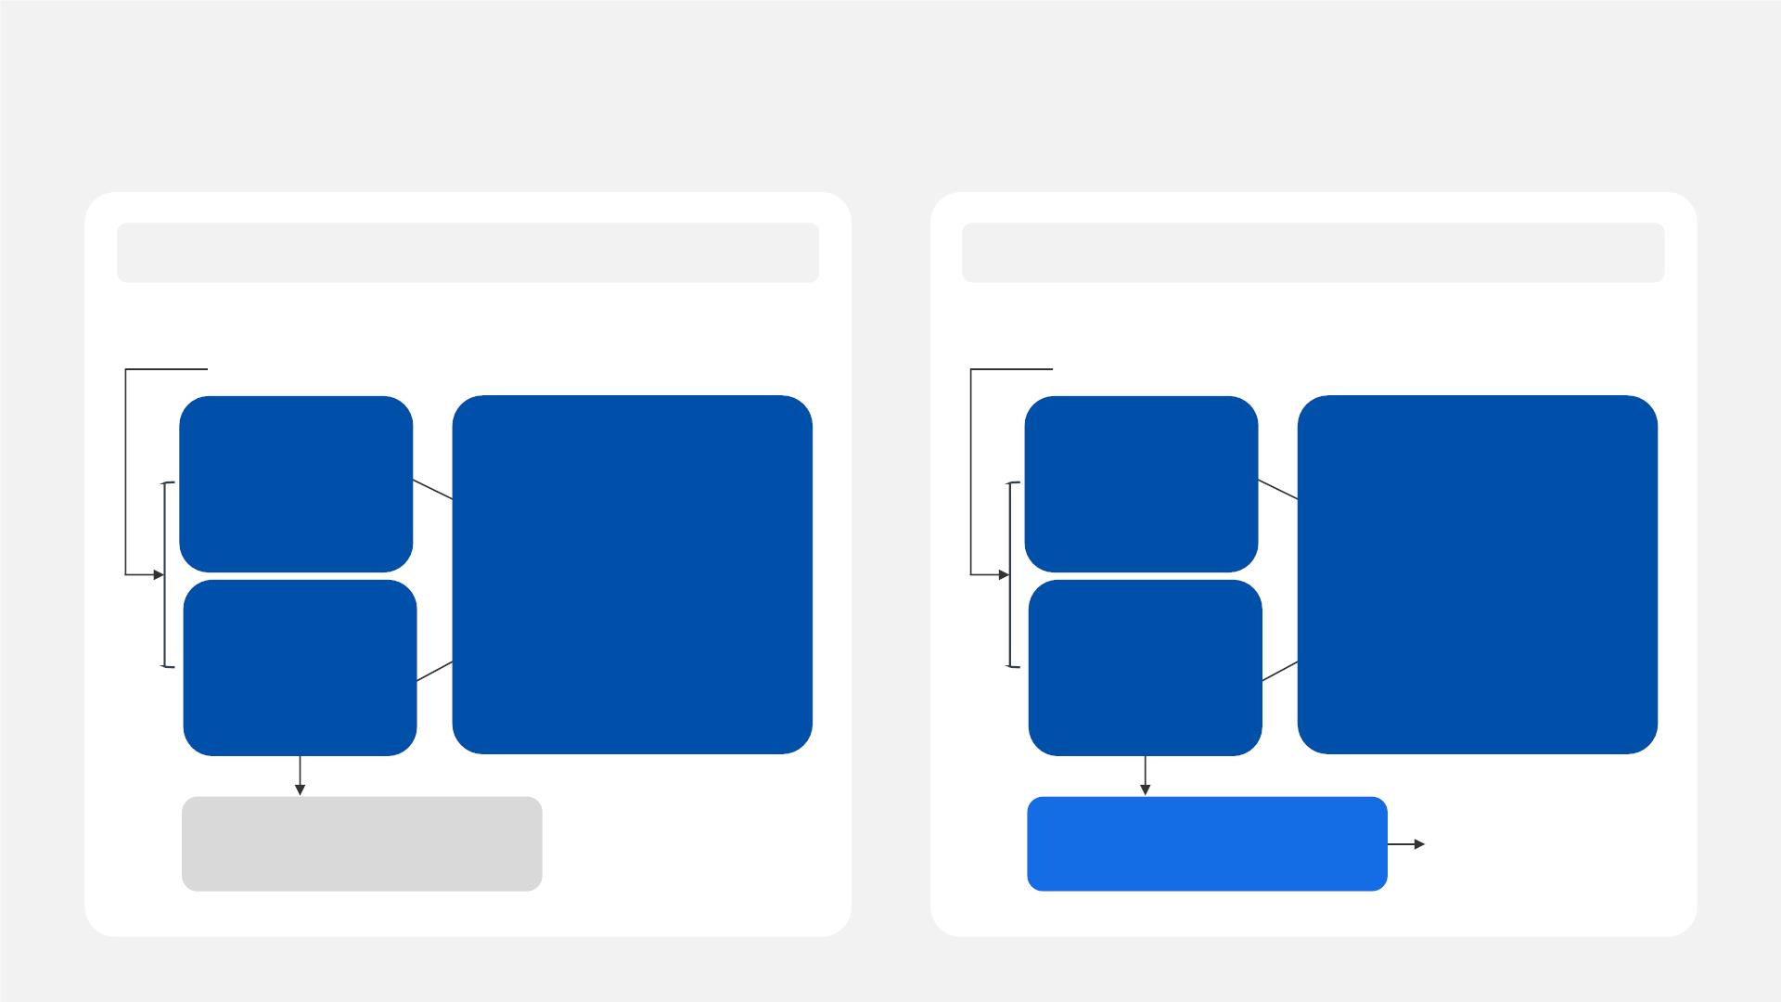
How Right-Sizing Can Increase Capacity — Example
Right-sized motors allow a 50 MW data center to re-allocate power to IT equipment, increasing revenue by 9%.
Standard Nameplate
Right-sized Nameplate
10 HP / 7.5 kW / 1800 RPM / 12 A
5.9 HP / 4.4 kW / 1225 RPM / 7.1 A
50 MW facility
50 MW facility
Cooling
Equipment:
Cooling
Equipment:
7.5 MW =
Power Allocation:
7.5 MW = cooling equipment
30 MW = IT Equipment
5.4 MW =
Power Allocation:
5.4 MW = cooling equipment
32 MW = IT Equipment
1,00 motors at
7.5 kW
1,200* motors at
4.4 kW
IT Equipment:
12.5 = fixed
IT Equipment:
12.5 = fixed
30 MW
32 MW
Servers: 105,000 servers
Revenue: $100 million
Servers: 114,000 servers
Revenue: $109 million
9% annual
revenue increase
13 ©2025 Infinitum | All rights reserved
Assumptions: These numbers are rounded for simplicity and are not exact.The revenue is chosen based on industry hosting charges. There are additional ways data centers make revenue but for simplicity purposes we have calculated revenue based on hosting charges1. 2.5 MW fixed power is allocated towards
the refrigeration chiller compressor, other IT equipment, and other mechanical equipment. With right-sizing, 3 MW of power can be re-allocated→ 2 MW to servers and 1 MW to additional cooling equipment for those servers. *1,200 motors include the additional motors needed to cool the extra servers.

Slide 14
How Right-Sizing Can Increase Capacity — Example
Right-sized motors allow a 72 MW data center to re-allocate power to IT equipment, increasing revenue by 9%.
Standard Nameplate
Right-sized Nameplate
10 HP / 7.5 kW / 1800 RPM / 12 A
5.9 HP / 4.4 kW / 1225 RPM / 7.1 A
72 MW facility
72 MW facility
Cooling
Equipment:
Cooling
Equipment:
11 MW =
Power Allocation:
24 MW = cooling equipment
48 MW = IT Equipment
7 MW =
Power Allocation:
20.5 MW = cooling equipment
52 MW = IT Equipment
1,445 motors at
7.5 kW
1,575* motors at
4.4 kW
IT Equipment:
13.5 = fixed
IT Equipment:
13.5 = fixed
48 MW
52 MW
Servers: 151,000 servers
Revenue: $101 million
Servers: 165,000 servers
Revenue: $110 million
9% annual
revenue increase
14 ©2025 Infinitum | All rights reserved
Assumptions: These numbers are rounded for simplicity and are not exact.The revenue is chosen based on industry hosting charges. There are additional ways data centers make revenue but for simplicity purposes we have calculated revenue based on hosting charges1. 3.5 MW fixed power is allocated towards
the refrigeration chiller compressor, and other mechanical equipment. With right-sizing, 4.5 MW of power can be re-allocated→ 4 MW to servers and .5 MW to additional cooling equipment for those servers. *1,575 motors include the additional motors (130) needed to cool the extra servers.

Slide 15
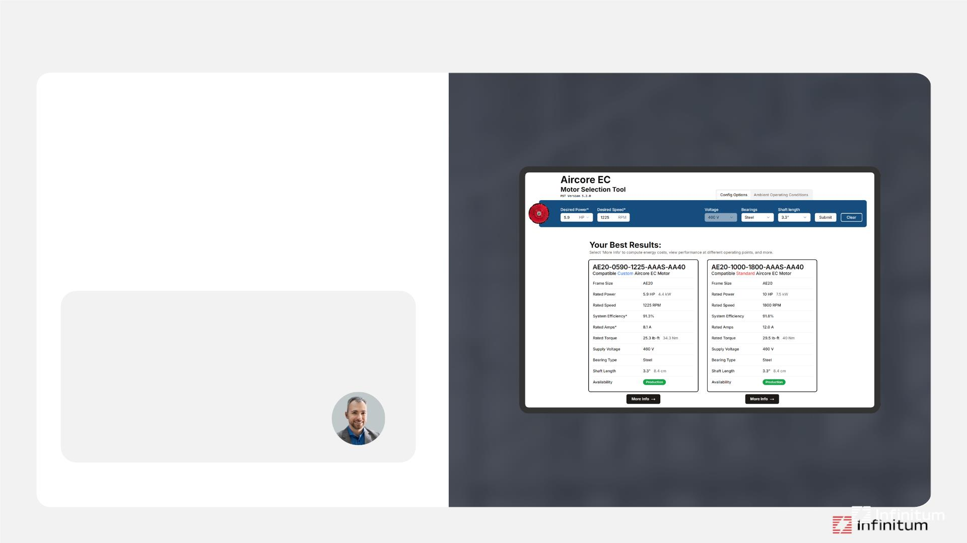
Infinitum Standard and Right-Sized Nameplates
Our Motor Selection Tool helps you find
the optimal nameplate to best match your
application's requirements.
With this tool, you can also:
• Download datasheets & drawings
• Customize parts
• Calculate energy savings
"Infinitum’s nameplating capability is an
extremely powerful offering as it can
drastically lower overall capital
investment associated with large
motor-driven systems.”
~ Blake Griffin, Interact Analysis
15 ©2025 Infinitum | All rights reserved

Slide 16
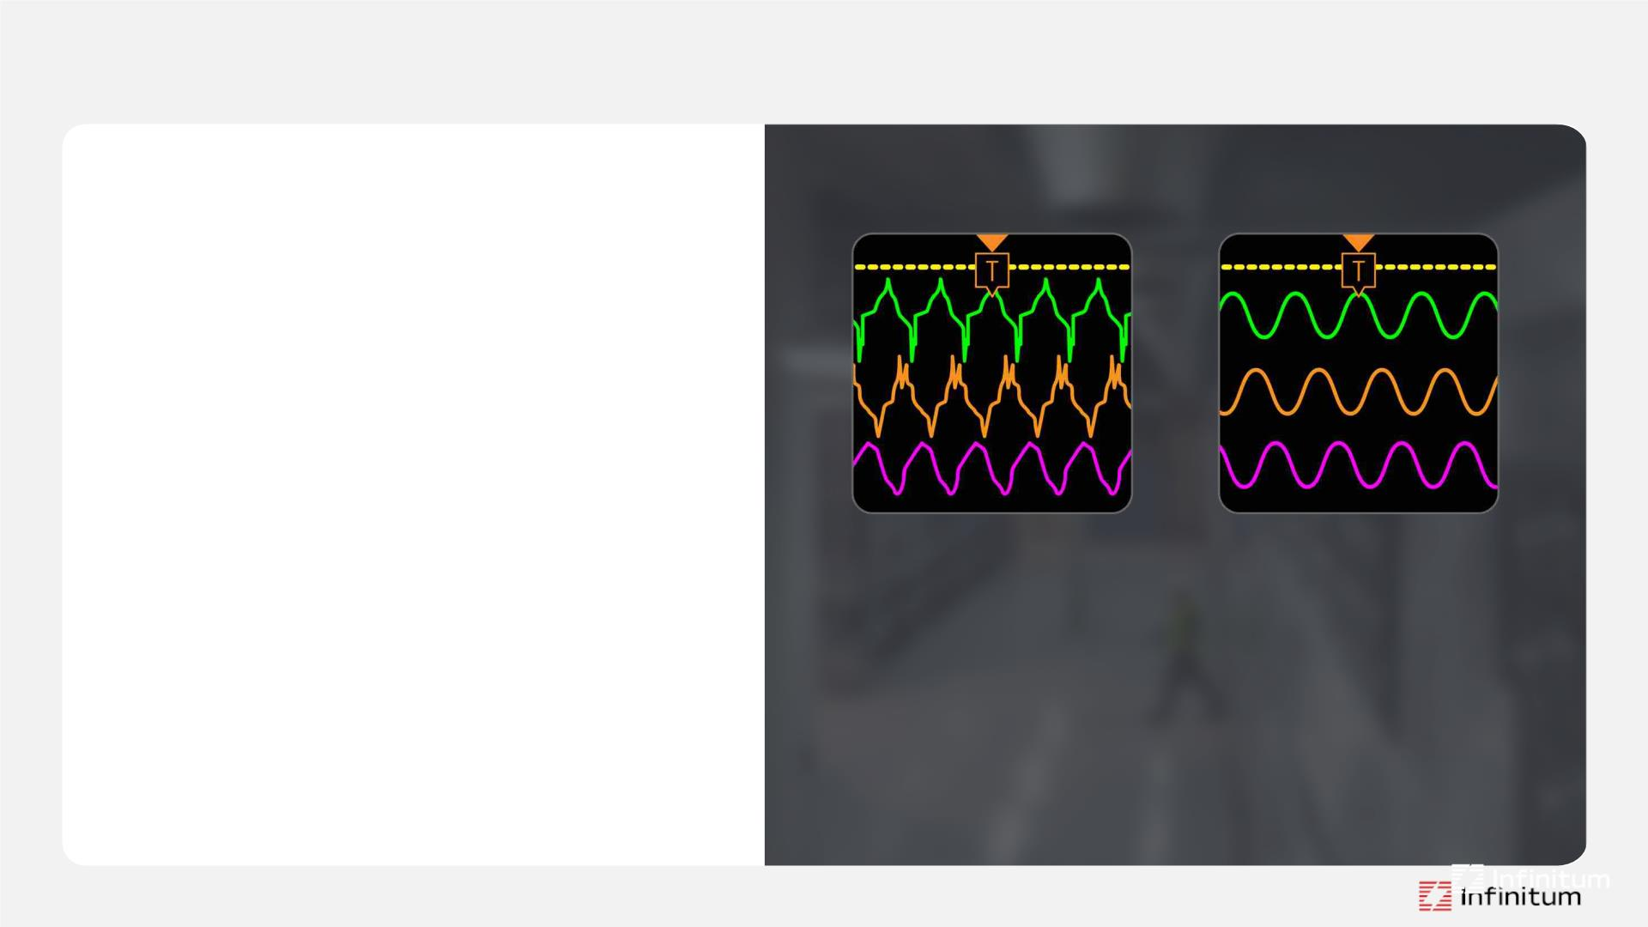
Mission Critical Motors — AFE (Active Front End)
AFE Technology for Cleaner, Smarter,
Resilient Power
When uptime is non-negotiable, Infinitum’s
Mission Critical motors deliver.
• IEEE 519 compliance
THDi as low as 1%
• Power factor of 98%
Less wasted energy
• Power loss ride-through capability
No motor dropouts during power transfer
10-HP, 1800 RPM
without AFE
10-HP, 1800 RPM
with AFE
• Low insertion loss
• Power Factor 82%
• Power Factor 98%
Less heat, longer motor life
• THDi >40% and
THDv 4.7%
• THDi 1.4% and
THDv 2.9%
• Designed for efficiency and sustainability
91%+ total system efficiency
• Input Current 12 A
• Input Current 11 A
• Retrofit ready
• System Efficiency 91%
• System Efficiency 91%
Upgrade to Mission Critical AFE in minutes
16 ©2025 Infinitum | All rights reserved

Slide 17
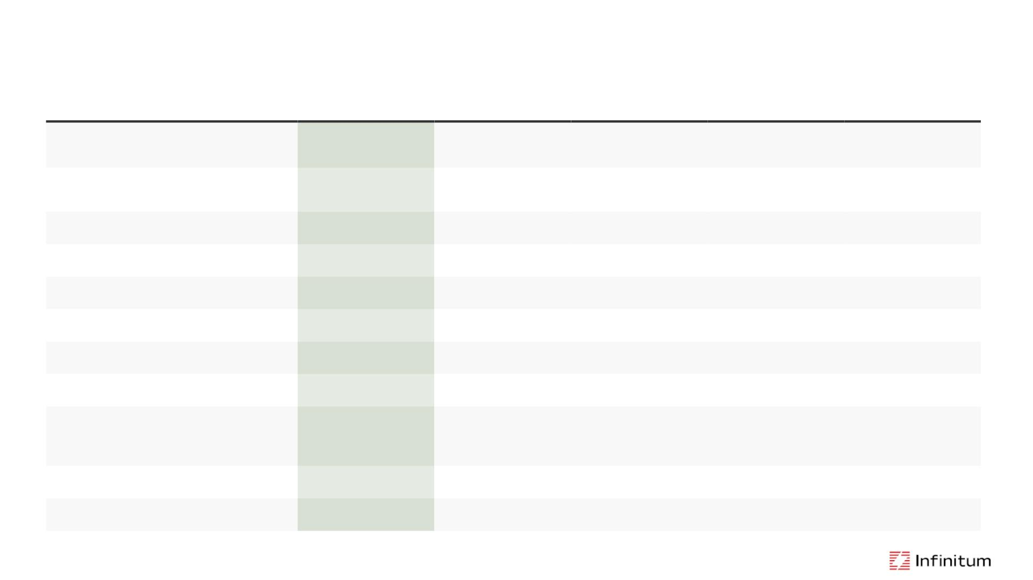
Comparison
Aircore Mission
Critical with AFE
EBM Papst
PFC
Ziehl-Abegg
PFC
Induction Motor
+ VFD with AFE
Passive Filter
IEEE519 Compliance
Yes, across full
operating range
Only at full load
Limited (1%)
Only at full load
Limited (1%)
Yes
Only at full load
Phase Imbalance
Voltage Regulation
Yes (3%)
Yes (3%)
NA
THDi @ 100% Load
THDi @ 50% Load
Right Sizing
2%
3%
5%
8-10%
No
5%
8-10%
No
3%
5%
5-10%
10-15%
No
Yes
Yes
ꢀ
No
Serviceability
No
No
No
No
Additional Footprint
Power-Loss Ride Through
ꢀ
ꢀ
ꢀꢀ
Best
ꢀꢀꢀ
Worse
Best
Better
Better
Additional Wiring +
Installation Costs
$$
Wiring + Tuning +
Contactor + Relay +
Installation Costs
$$$
Incremental Upfront Cost
$$
$$
$$
Operating Costs
$
$
$
$
$$
$$$
Total 5-year Cost of Ownership
$$
$$
$$$
$$$$
17
©2025 Infinitum | All rights reserved

Slide 18
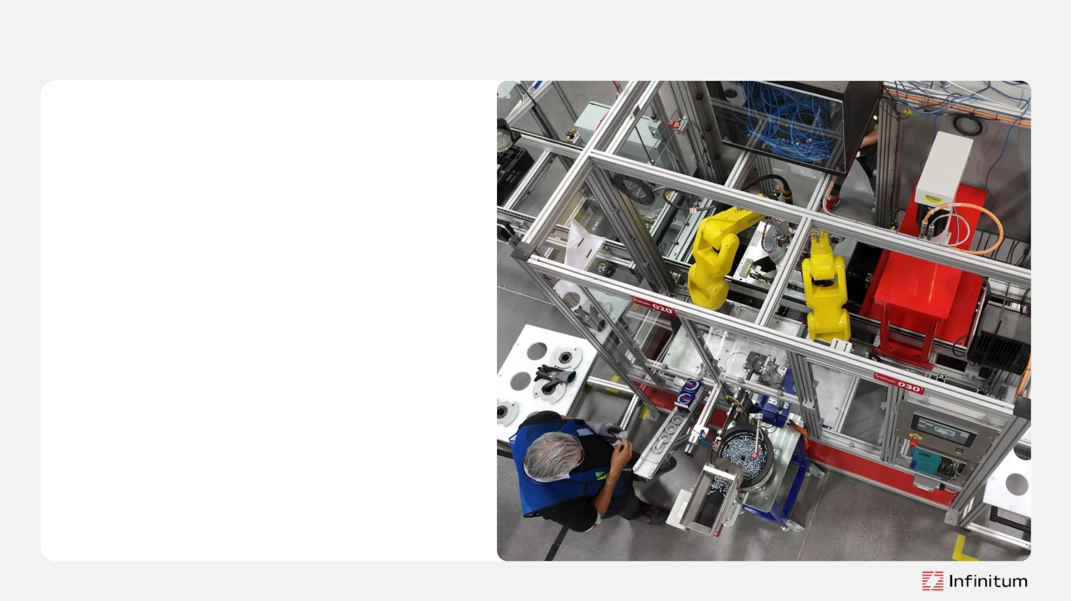
Manufacturing Operations
Our robotics and semi-automated
assembly technology ensures every motor
meets the highest industry standards
• Manufacturing capability 200,000+
motors annually
• Two RAM cells and one semi-automated
assembly line for rapid scaling and
low/high-mix volume
• 10 motors / hour / line (6-minute takt time)
• 800 motors / 5-day work week / line
• 153,600 motors annual capacity / 4 lines
• 1,228,800 motors annual capacity / 32 lines
• 115,000 sqft — ISO9001 certified facility
18 ©2025 Infinitum | All rights reserved

Slide 19

Quality & Traceability
Semi-automated, AI-integrated assembly
line for unmatched accuracy and
consistency
• Every motor tracked from initial assembly
to final inspection
• Cloud-based SCADA system logs every
decision and component
• Full photographic and data traceability for
complete confidence
• Operator and machine-validated quality
checks
19 ©2025 Infinitum | All rights reserved

Slide 20
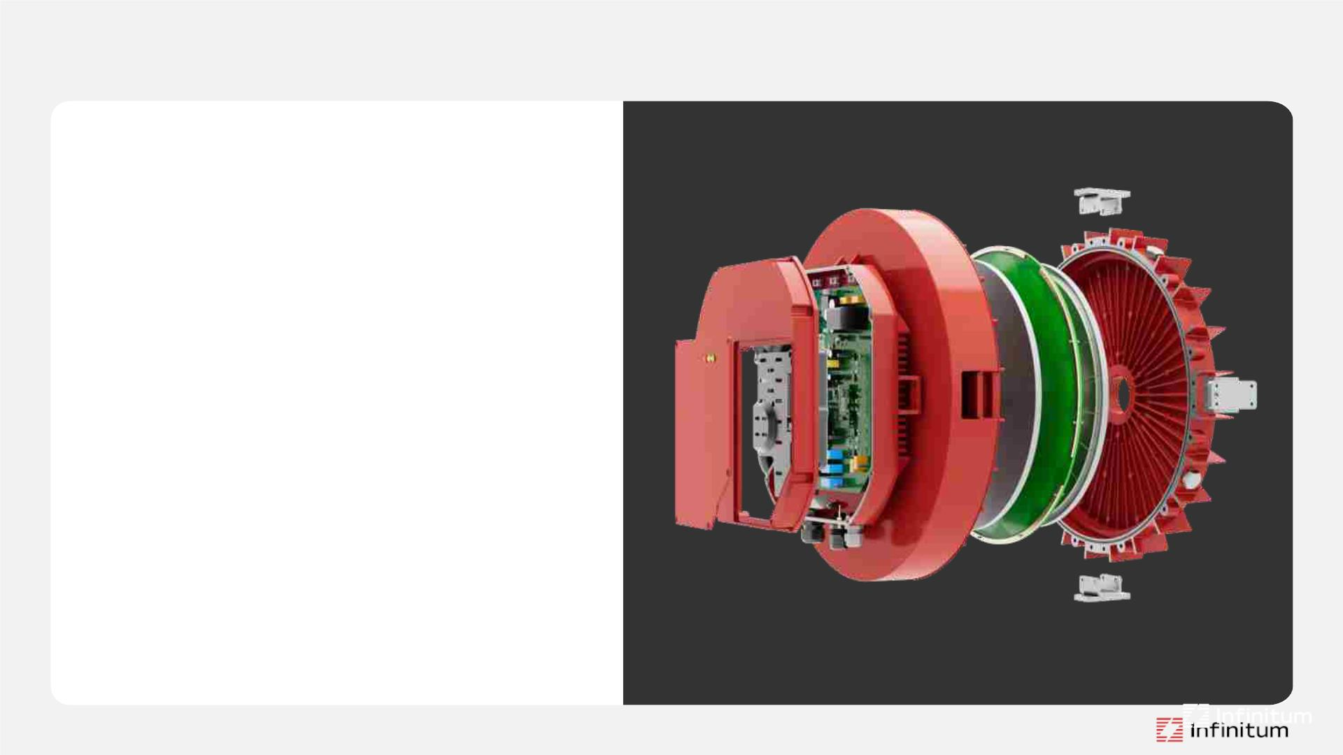
Reliability by Design with Lifecycle Services
Comprehensive, scalable maintenance
and parts service to keep motors
running smoothly
• Tailored service plans
• Repair and maintenance
• Maintain availability
Accelerated Lifetime Testing (ALT)
Conducted by 3rd party labs
• Rigorous/continuous performance
and environmental testing conducted
at Infinitum R&D lab
20 ©2025 Infinitum | All rights reserved

Slide 21
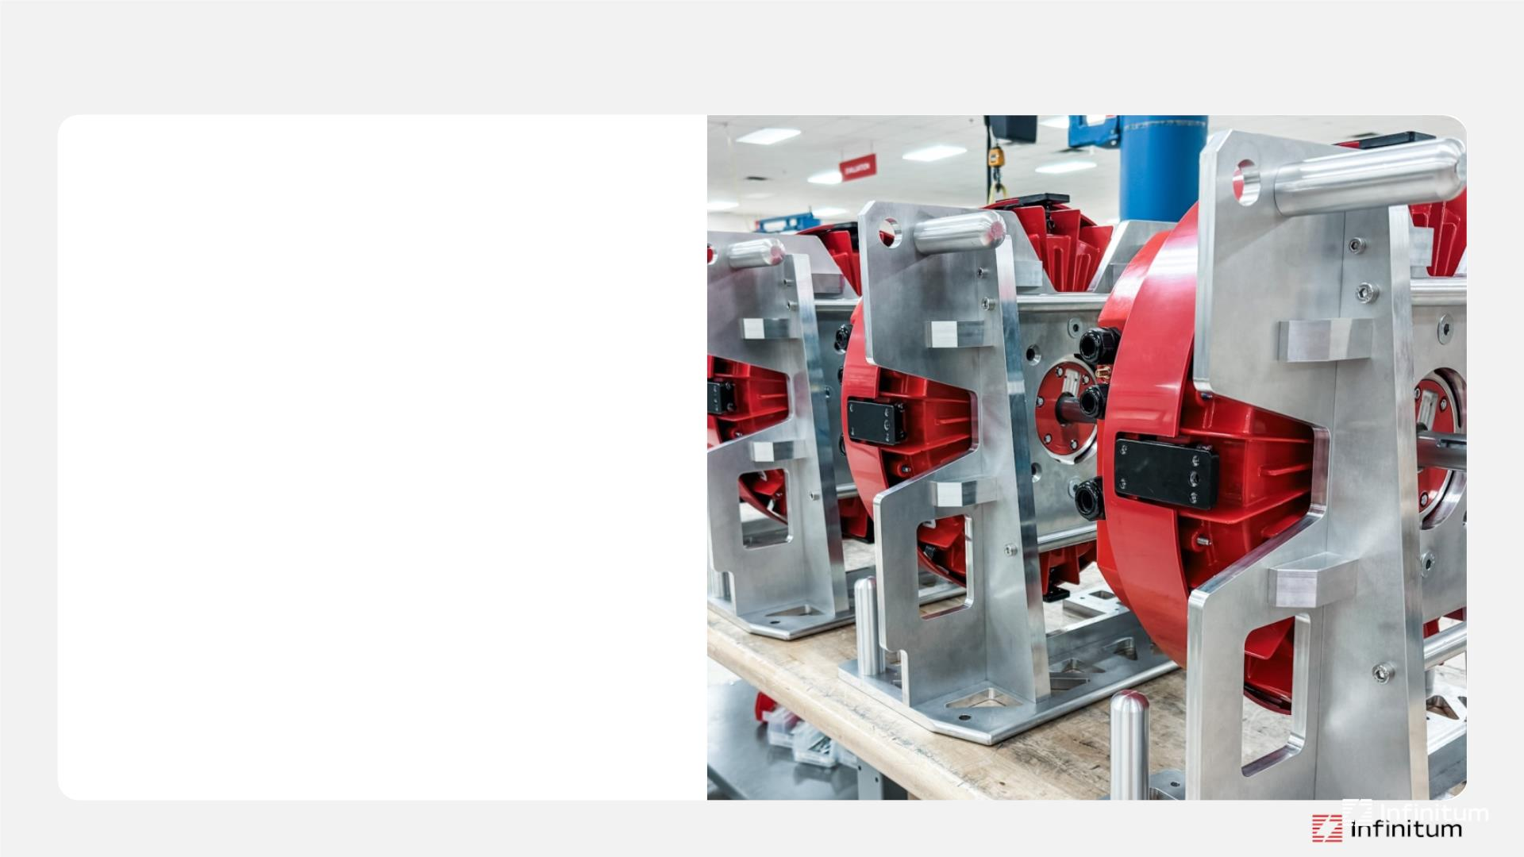
Sustainability by Design
We reuse what we can,
recycle what we can’t,
and remanufacture motors
to give them a second life.
• Modular design for easy serviceability
• The majority of our components
can be reused or recycled
• Motors us 66% less copper,
produces 30% fewer emissions,
and consumes 10% less energy
21 ©2025 Infinitum | All rights reserved

Slide 22
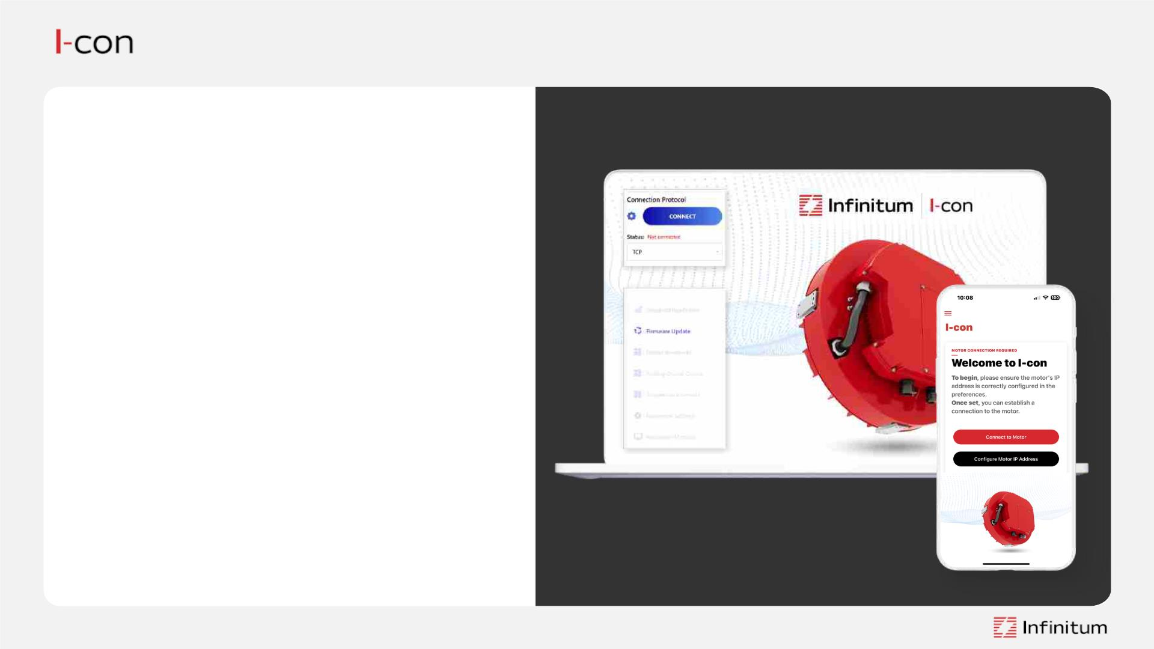
Motor Control Software
Provides motor configuration,
monitoring, and firmware control
• Download the software manual
• Download the communication & control
software
• Connect with ethernet or serial link
• Pre-configure the laptop/PC ethernet
card with a static IP address
• Connect an ethernet cable from laptop
to the motor control board or use serial
connection
• Apply power to the motor
• Videos for power and control wiring are
also available on our website
22 ©2025 Infinitum | All rights reserved

Slide 23
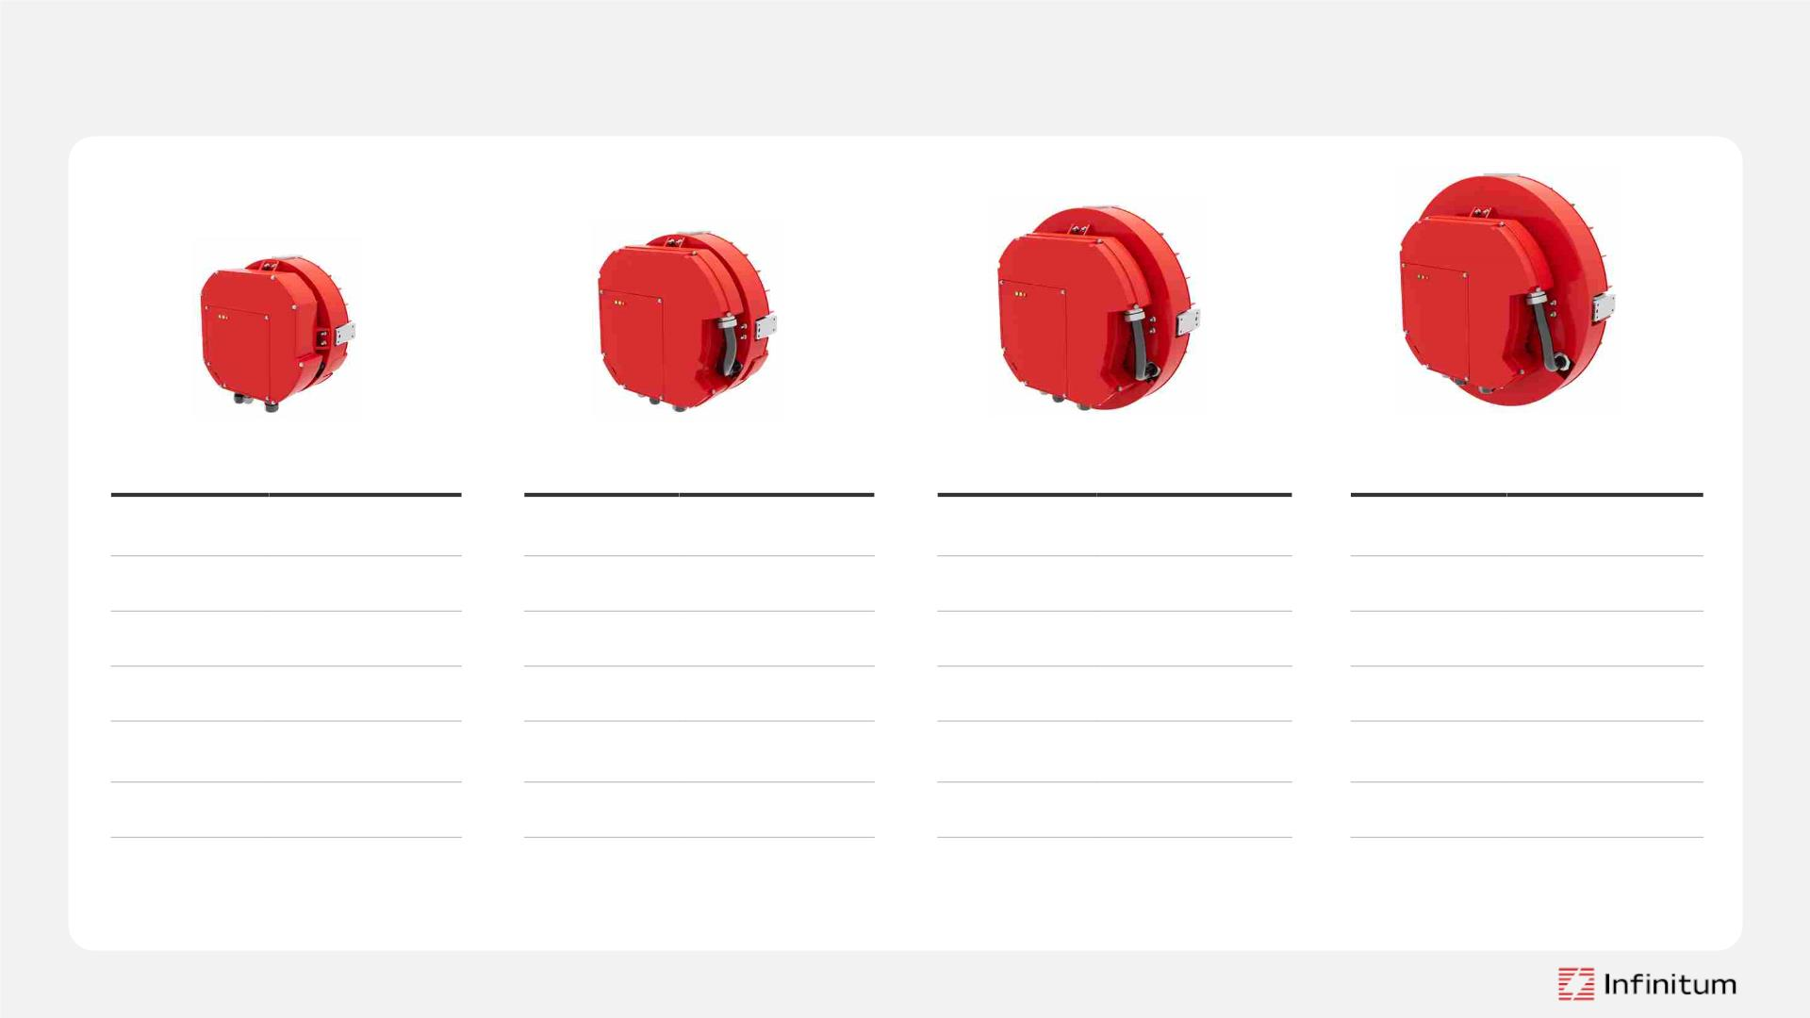
Infinitum Aircore EC Motor Operating Range
Aircore EC Frame 13
Aircore EC Frame 15
Aircore EC Frame 18
Aircore EC Frame 20
Power:
1-5 HP
(.75-3.73 kW)
Power:
5-7.5 HP
(3.73-5.6 kW)
Power:
7.5-10 HP
(5.6-7.46 kW)
Power:
10-15 HP
(7.46-11.19 kW)
RPM Range: 100–5040 RPM
RPM Range: 100–4320 RPM
RPM Range: 100–4320 RPM
RPM Range: 100–4320 RPM
Voltage:
415, 460, 575 (HRG)
62.8 lbs (28.5 kg)
Voltage:
415, 460, 575 (HRG)
81.4 lbs, 36.9 kgs
Voltage:
415, 460, 575 (HRG)
96.1 lbs, 43.6 kgs
Voltage:
415, 460, 575 (HRG)
128.1 lbs, 58.1kgs
Weight:
Weight:
Weight:
Weight:
Rated Torque:
IP Rating:
6.3–7.4 lb-ft
(8.5– 10.0 Nm)
Rated Torque:
IP Rating:
Dimensions:
11.1–14.8 lb-ft
(15– 20 Nm)
Rated Torque:
IP Rating:
Dimensions:
14.6–22.1 lb-ft
(20.0-30.0 Nm)
Rated Torque:
IP Rating:
Dimensions:
22.1-44.3 lb-ft
(30.-60.0 Nm)
IP54 / IP65
IP54 / IP65
IP54 / IP65
IP54 / IP65
Dimensions:
14.5” x 9.1” w/o shaft
(36.7 x 23.1 cm)
16.4” x 8.7” w/o shaft
(41.17 x 22.1 cm)
18.6” x 8.7” w/o shaft
(47.2 x 22.1 cm)
21.1” x 8.9” w/o shaft
(53.7 x 22.5 cm)
23 ©2025 Infinitum | All rights reserved

Slide 24
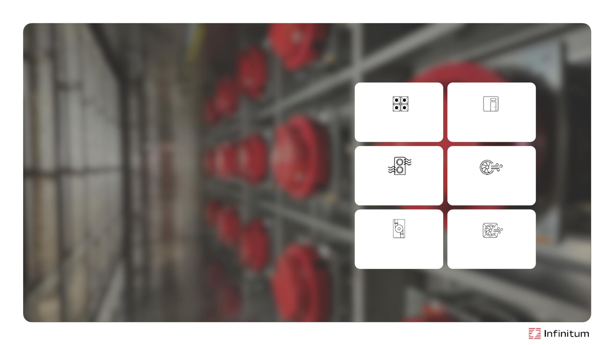
Data Center
Applications
Fan Array
CRAC / CRAH
CDU
AHU / IDEC
Centrifugal Fans
Axial Fans
• AFE delivers superior power quality and
efficiency for mission-critical systems
• Reduced harmonics to <5% THD
• 99% Power factor, reducing the need for
costly electrical gear
• Exceeds IEEE STD.519 for peak performance
in high-demand environments
24 ©2025 Infinitum | All rights reserved

Slide 25

Heavy Duty
Applications
Pumps
Conveyors
Cooling
Blowers
Vacuums
Reliability and Durability:
• Oversized bearings and shaft size
• Efficient, brushless operation with no commutation losses
• Quiet, precise variable speed control
Protection against Dust and Water:
• Dust-tight and protected against water
• Rugged design suitable for harsh/hazardous environments
Pressurization
25 ©2025 Infinitum | All rights reserved

Slide 26
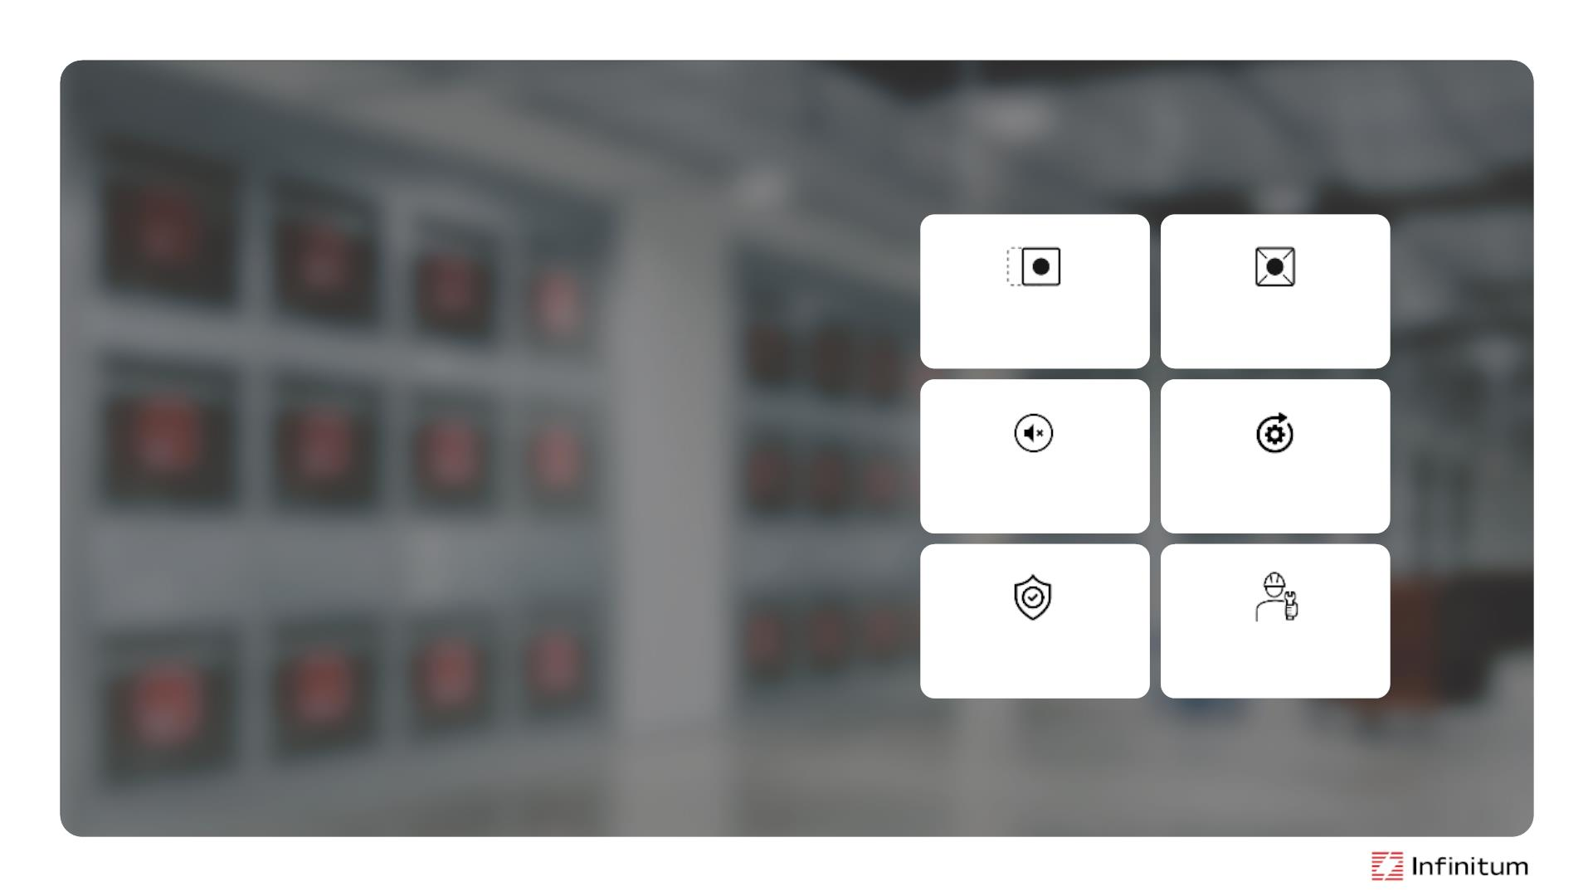
Retrofit
Fan Systems
Plug-and-play
Modular
Efficient
• Modernization made easy
Boost PUE and cut energy costs with maximum
efficiency and long-term savings
Quiet
• Service you can rely on
Our modular systems simplify repairs and
replacements, with minimal maintenance
• Designed to make life easier
Our experts manage everything—from assessment
to installation—ensuring a fast, seamless transition
Drop in to leading EC Fan Systems (centrifugal
and axial fans)
Reliable
Serviceable
26 ©2025 Infinitum | All rights reserved

Slide 27
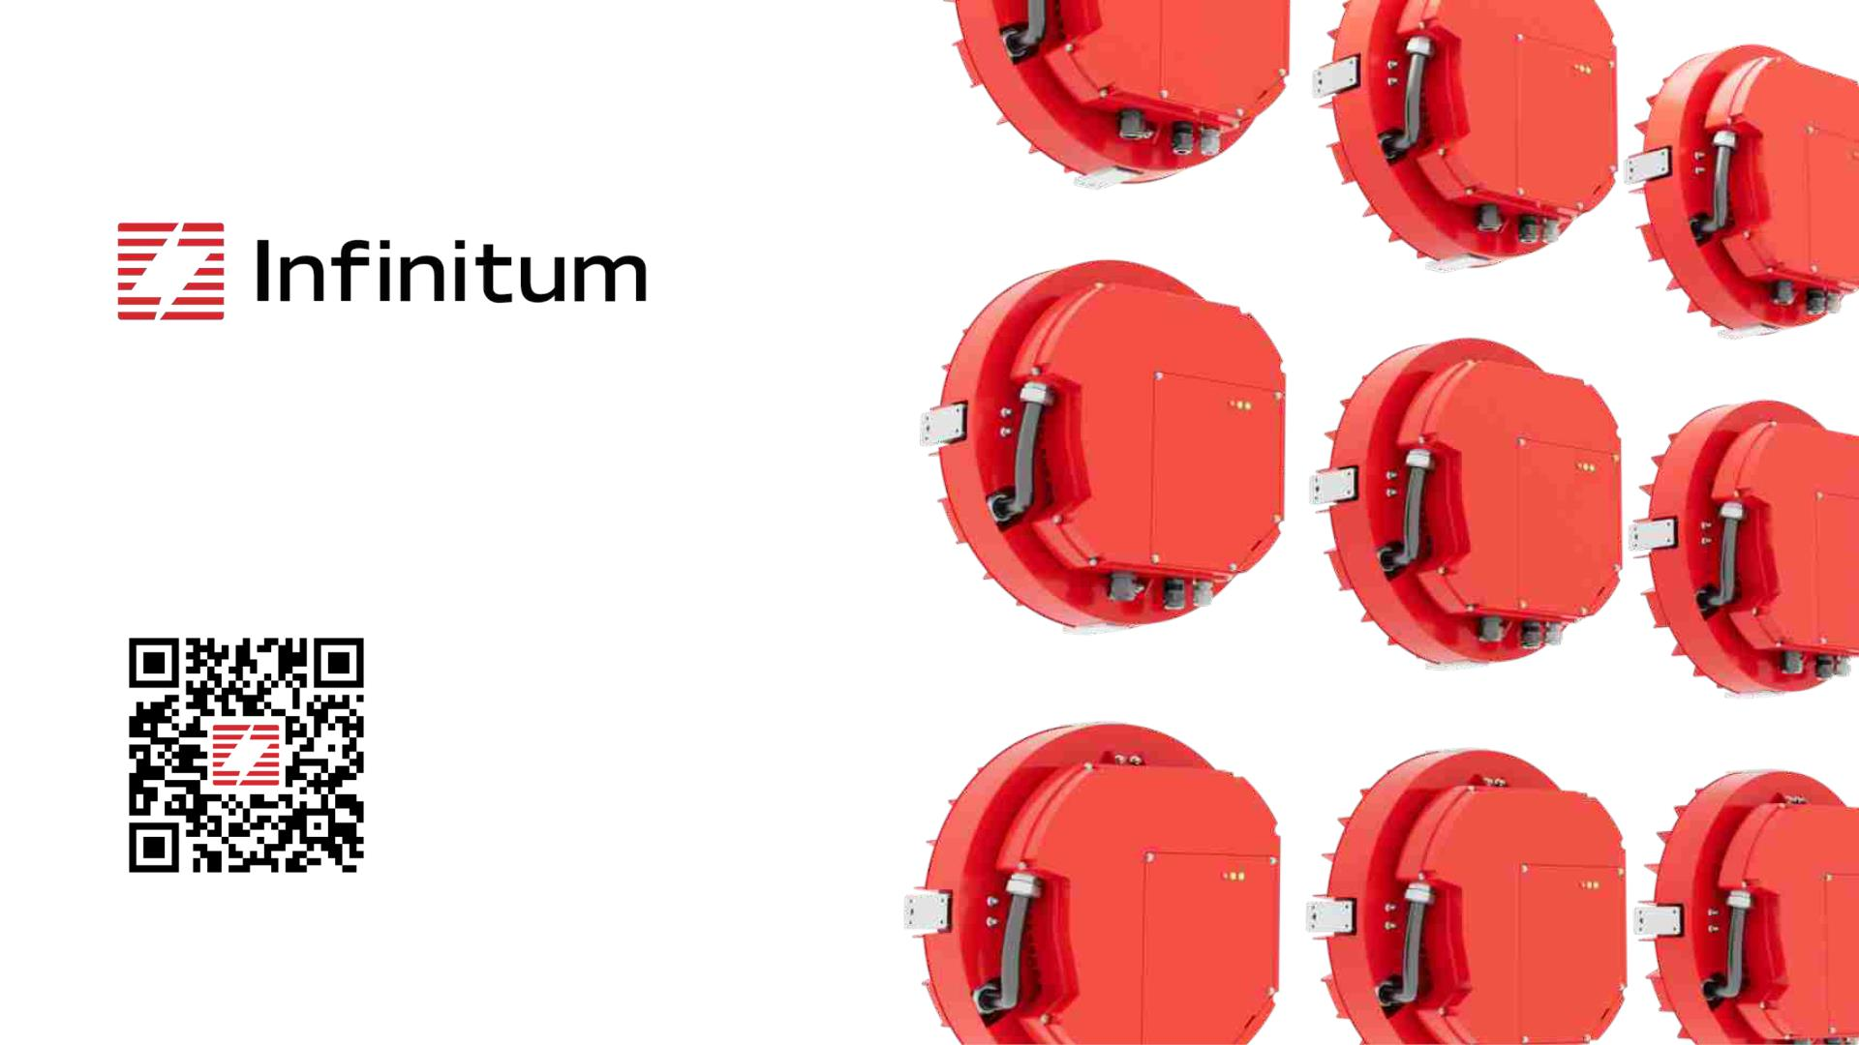
goinfinitum.com

